Slide 1
Using Program Builder
By Sam Bray

Slide 2
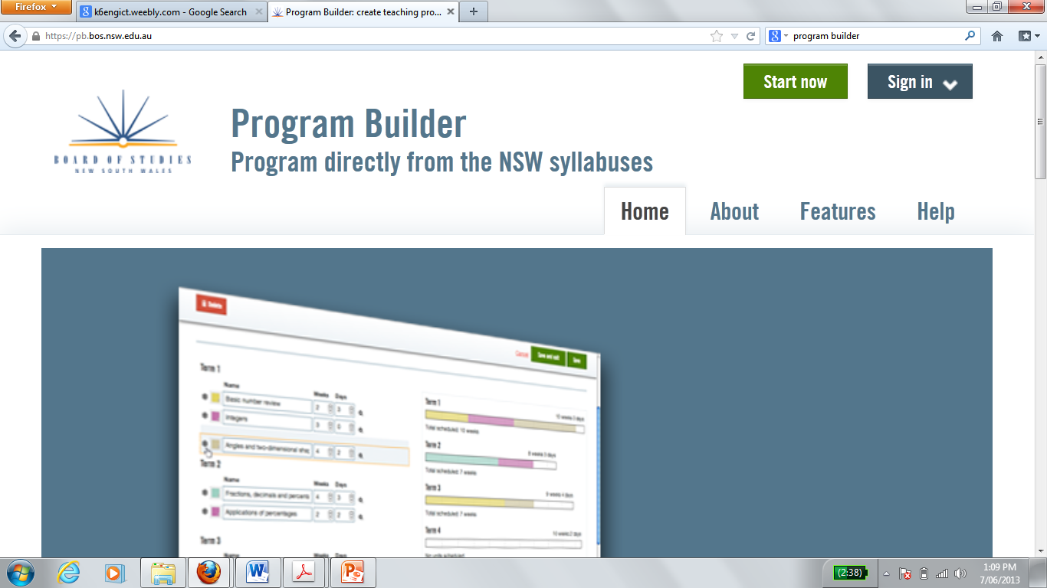
Finding Program builder
https://pb.bos.nsw.edu.au/
Or google ‘program builder’
Log in using your DEC username and password

Slide 3
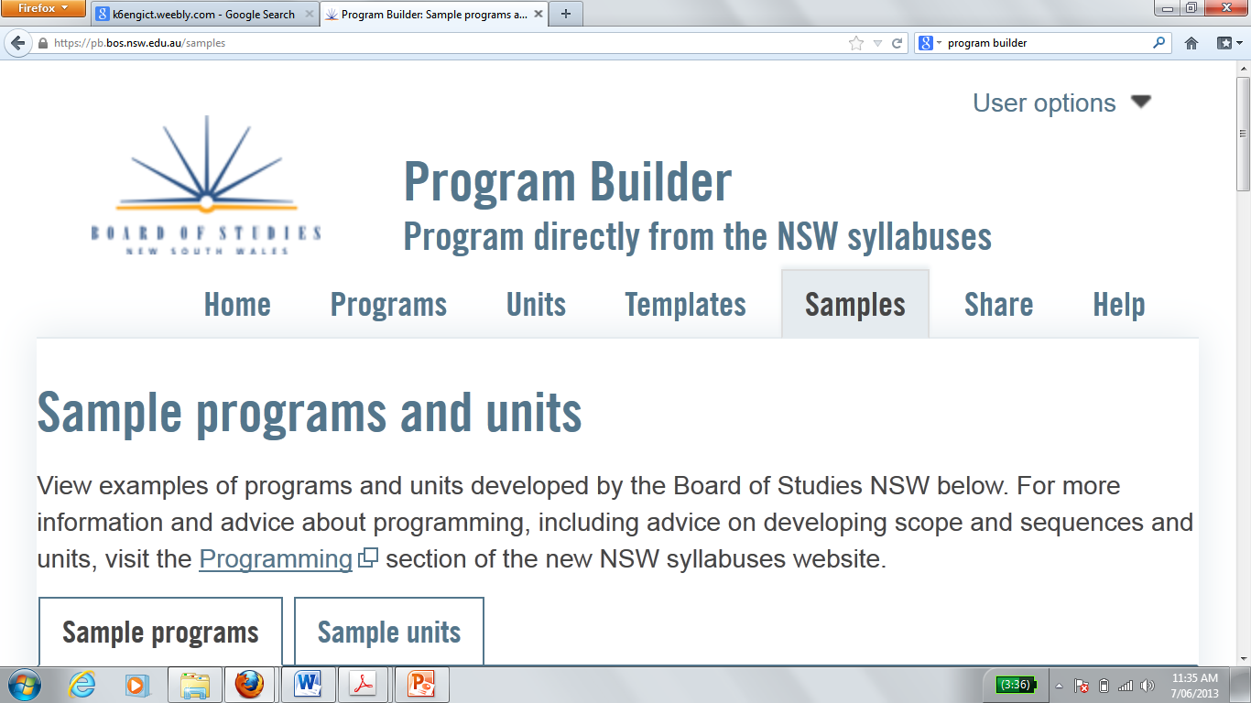
Looking at sample units
Click on ‘samples’ tab

Slide 4
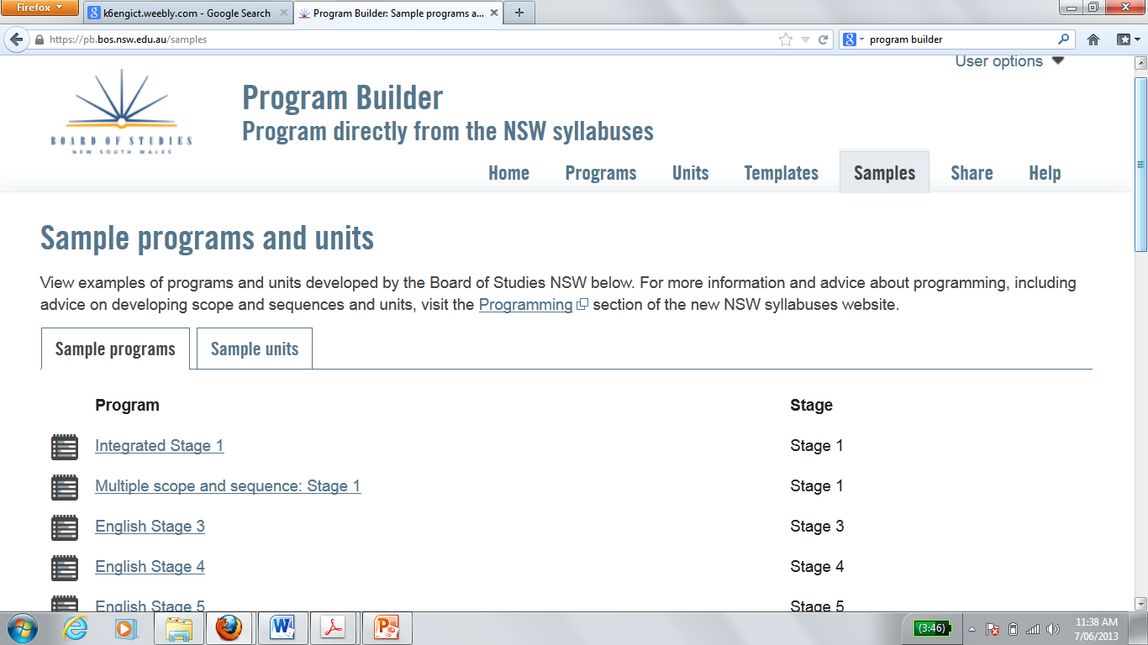
Choose a sample program
Click on a sample program from your stage and have a play (3 mins).
Programs include the timing of a program and the outcomes only.

Slide 5
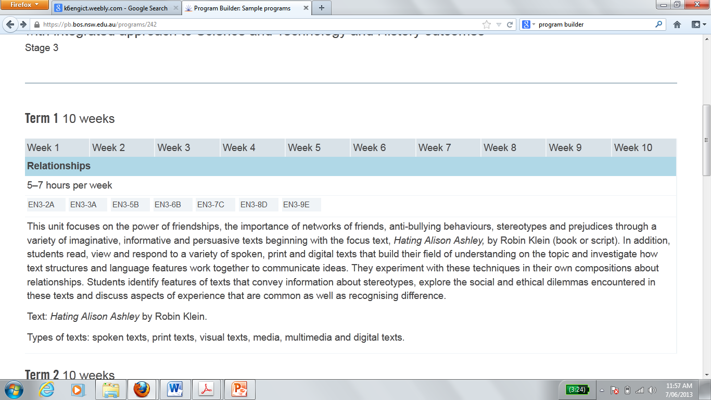
Sample programs
If you click on a highlighted unit it will take you to this unit (most of these are not completed).
Click on highlighted unit

Slide 6
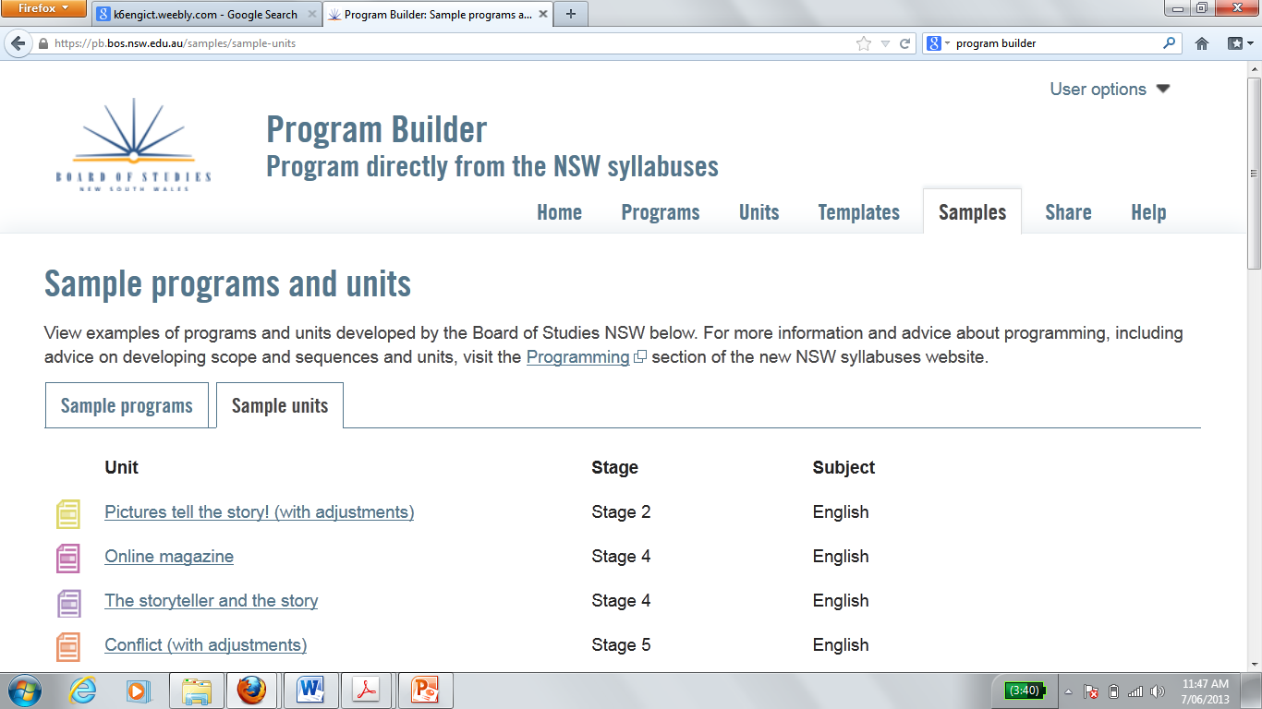
Choose a sample unit
Click on a sample unit from your stage and have a look (3 minutes).
Units include all the content.

Slide 7
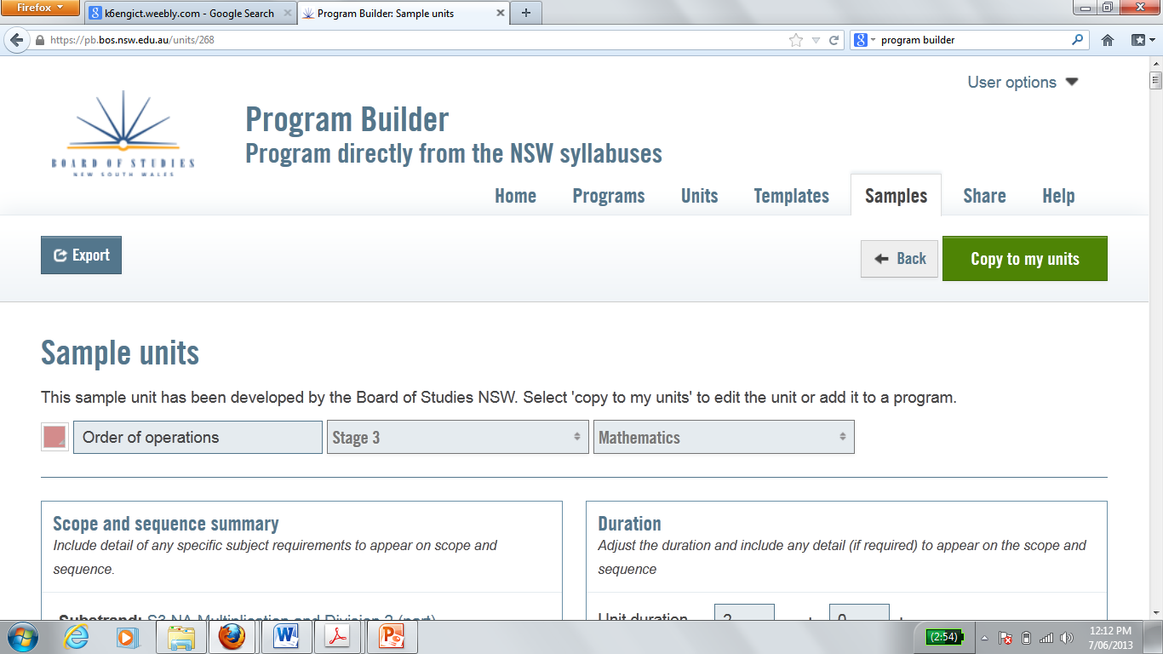
Copy a unit
Copy the unit by clicking green tab.
You can now edit this unit.

Slide 8
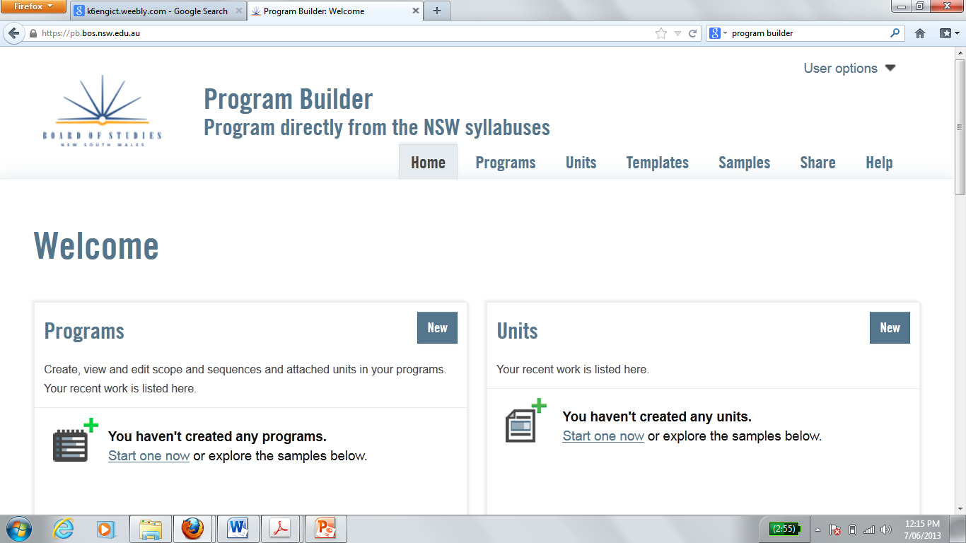
Create you own unit/ program

